Slide 1
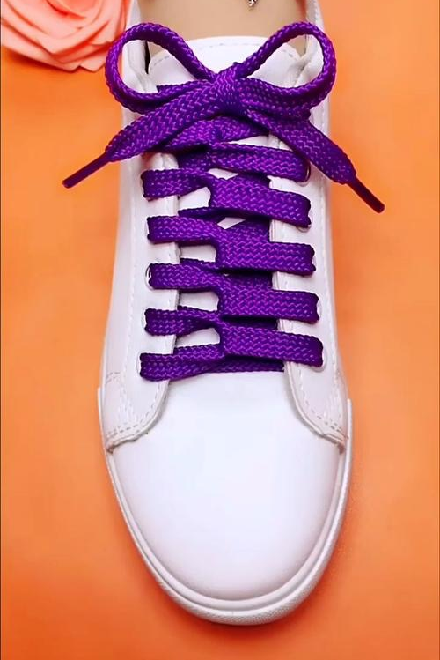
bow v. /baʊ/
He bowed slightly before taking her bag.
They ran to the center of the stage to take their bows.
The prisoner ____ ____ _____ _____ ______. 羞愧地低下了他的头
The trees bowed in the wind.
国会也许会屈服于公众压力，解除武器禁运。
Congress may _____ _____ public _______ and lift the arms embargo.
bow n. /bəʊ/ 他佩带着弓箭。He was armed with a bow and arrow.
tie your shoelaces in a bow
bowed his head in shame
bow to stress
Notes:
鞠躬
take a bow 谢幕，鞠躬答谢
点头
bend

Slide 2
He pretended to his family (that) everything was fine.
He ______ ____ ____ notice. 他假装不在意
She pretended an interest she did not feel. (formal)
I can't pretend to any great musical talent.
自称，自认为 I can’t pretend that…
The book doesn't pretend to be a great work of literature.
这本书并未自封为文学杰作。
I don't think she was hurt. She was just putting it on.
She assumed an air of concern.
Rob faked suspicion.
pretended not to
Notes:
装作
adopt a more casual tone of voice

Slide 3
【语境应用】语法填空。
Several young men pretended ________________ (be) policemen, but were caught at last.
He pretended __________________ (type) when the boss came in.
He pretended ______________ he didn’t mind, but I knew that he did.
to be
to be typing
that

